Slide 1
Raven Security Engagement
Attack, Defense & Analysis of a Vulnerable Network
Network Analysis
Henry Bartechko
Gayle Johnson
David Miles
Semeho Quadjovie
Ryan Cox
Jay Giunta

Slide 2
Table of Contents
This document contains the following resources:
Network Topology & Critical Vulnerabilities
Traffic Profile
Normal Activity
Malicious Activity
Table of Contents

Slide 3
Network Topology
& Critical Vulnerabilities
3

Slide 4
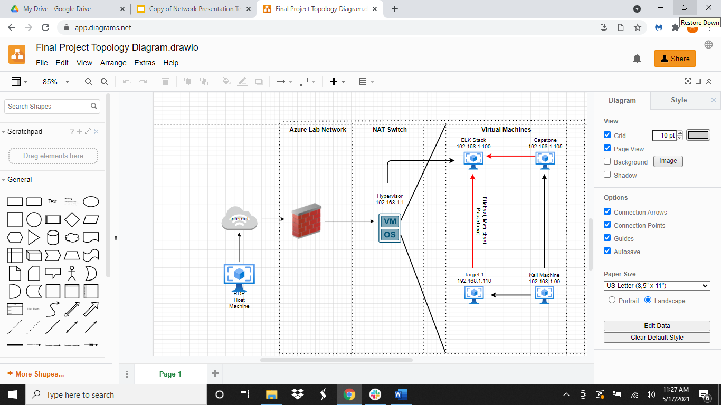
Network Topology
[Insert Here]
Use draw.io to create a diagram of the network.
Add your diagram to this slide and fill out the data in the sidebar.
Network
Address Range: 192.168.1.0/24
Netmask:255.255.255.0
Gateway:192.168.1.1
Machines
IPv4: 192.168.1.1
OS: Windows
Hostname: Hypervisor
IPv4: 192.168.1.105
OS: Linux
Hostname: Capstone
IPv4: 192.168.1.100
OS: Linux
Hostname: ELK Stack
IPv4: 192.168.1.110
OS: Linux
Hostname: Target 1
IPv4: 192.168.1.90
OS: Linux
Hostname: Kali
Network Topology: Diagram & IP Addresses

Slide 5
Critical Vulnerabilities: Target 1
Our assessment uncovered the following critical vulnerabilities in Target 1.
Vulnerability | Description | Impact
CWE-521: Weak Password Requirements Username: michael Password: michael | Password policy does not require that users should have strong passwords, which makes it easier for attackers to compromise user accounts. | Access Control: An attacker could easily guess user passwords and gain access user accounts.
CWE-540: Inclusion of Sensitive Information in Source Code http://192.168.1.110/service.html View page source | Source code on a web server or repository often contains sensitive information and should generally not be accessible to users. | Confidentiality: Allows an attacker to understand the logic of the script and extract extremely useful information such as code bugs or logins and passwords.
CVE-2015-6565: OpenSSH 6.8 < 6.9 - 'PTY' Local Privilege Escalation sudo python -c ‘import pty; pty.spawn(“/bin/bash”)’; | Allows local users to cause a denial of service (terminal disruption) or possibly have unspecified other impact by writing to a device, as demonstrated by writing an escape sequence. | Access Control: An attacker could easily escalate to root privileges using a simple python script.
Critical Vulnerabilities: Target 1

Slide 6
Traffic Profile
6

Slide 7
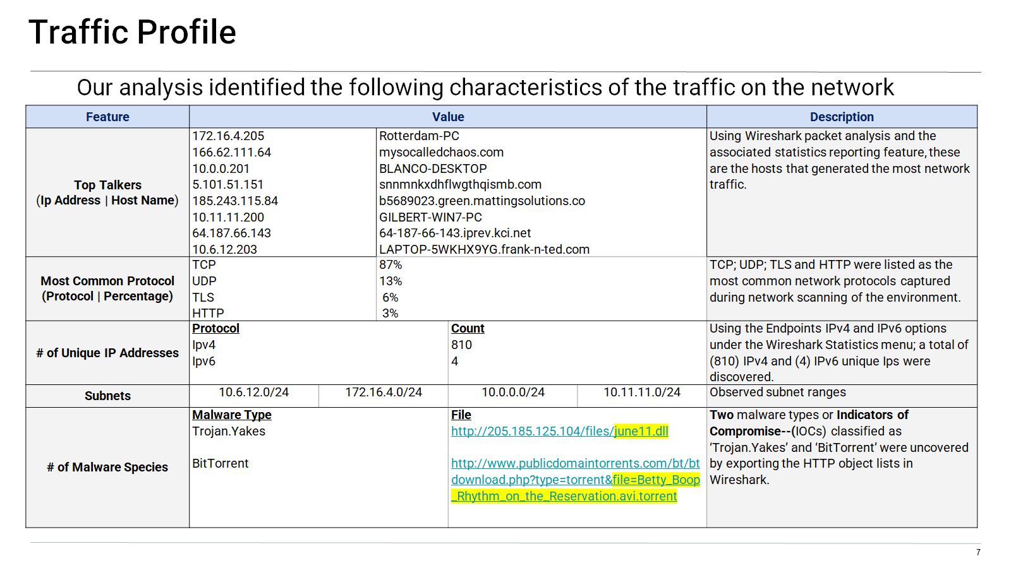
Traffic Profile: Characteristics
Notes:
You may have more than 2 subnets.

Slide 8
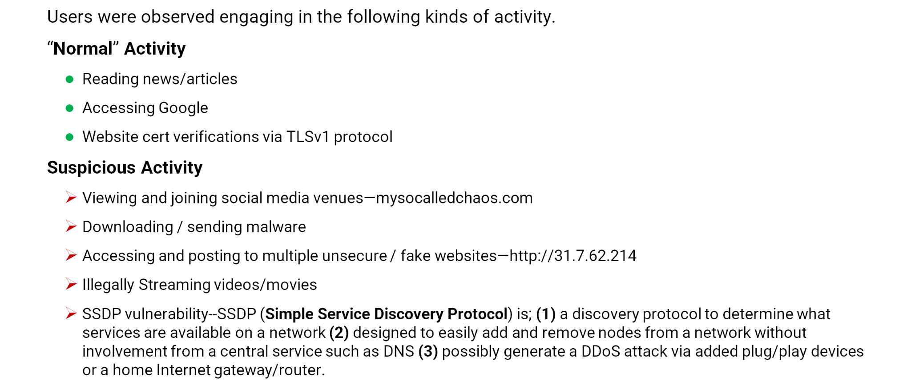
Behavioral Analysis
Purpose of Traffic on the Network
Traffic Profile: Behavioral Analysis

Slide 9
Normal Activity
9

Slide 10
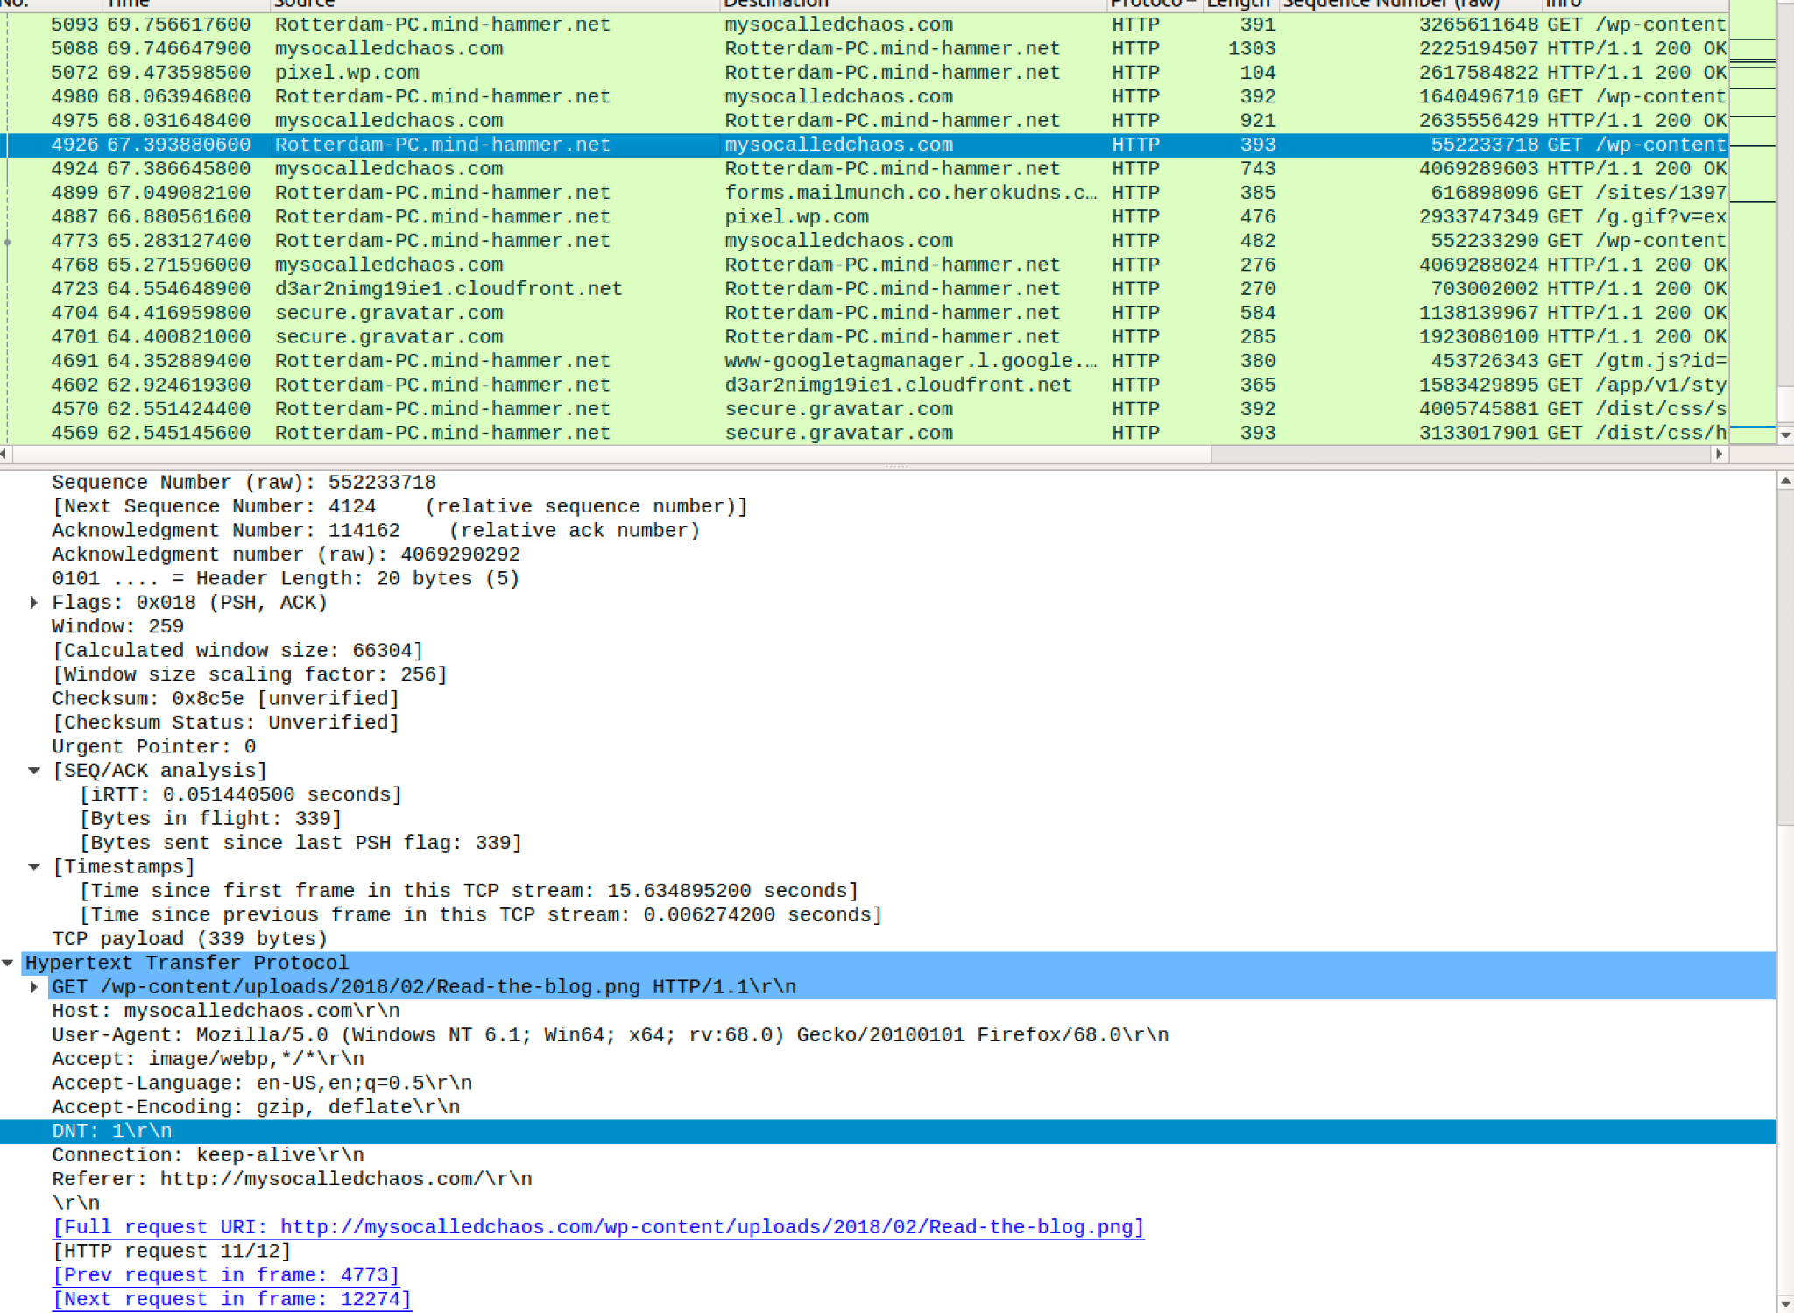

Web Browsing
The interested party at 172.16.4.205 visited the website mysocalledshaos.com to peruse the blog
Normal Activity: Web Browsing

Slide 11
Malicious Activity
11

Slide 12
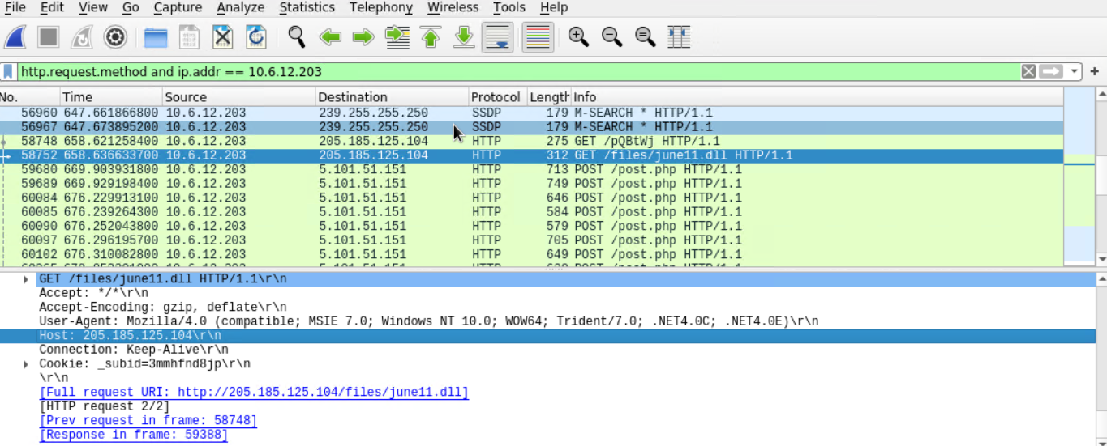
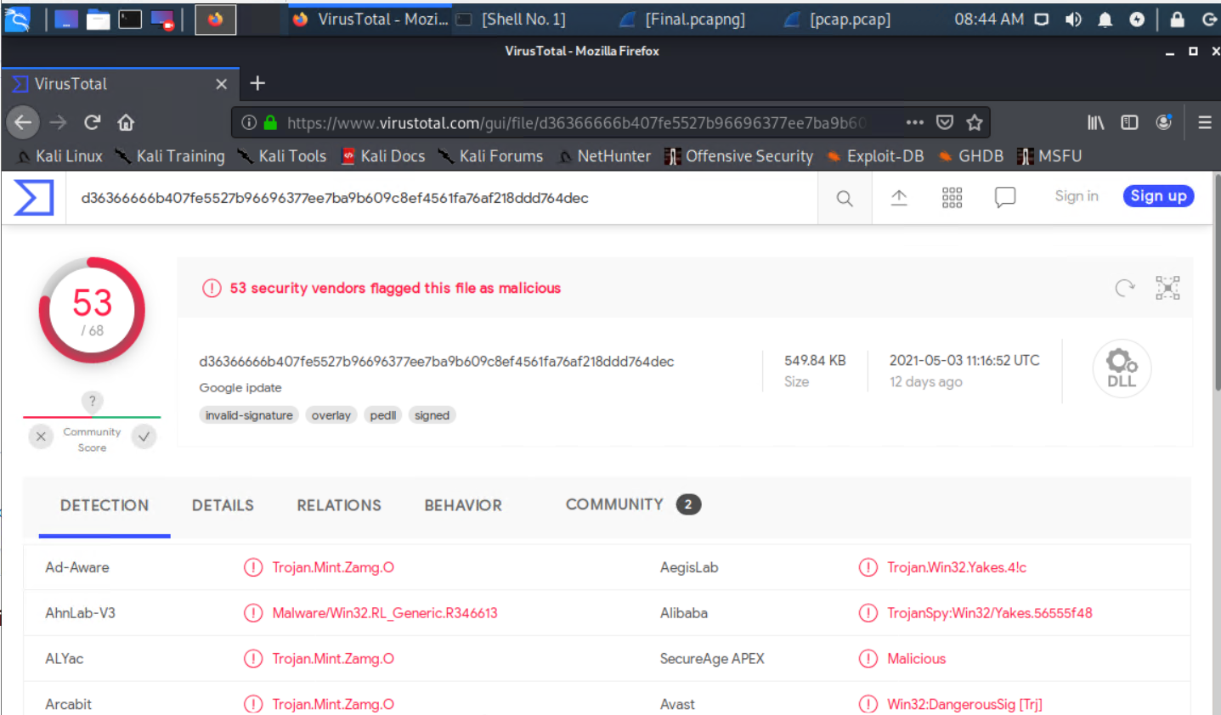
Downloading Malware
What kind of traffic did you observe? Which protocol(s)? The traffic observed includes multiple HTTP GET & POST requests from 10.6.12.203. Protocols used include HTTP & TCP.
What, specifically, was the user doing? Which site were they browsing? Etc. The user was browsing a website with an IP address of 205.185.125.104, where the user was redirected to malicious webpage.
Include a description of any interesting files. The file ‘june11.dll’ is a Trojan.
Malicious Activity: Downloading Malware

Slide 13
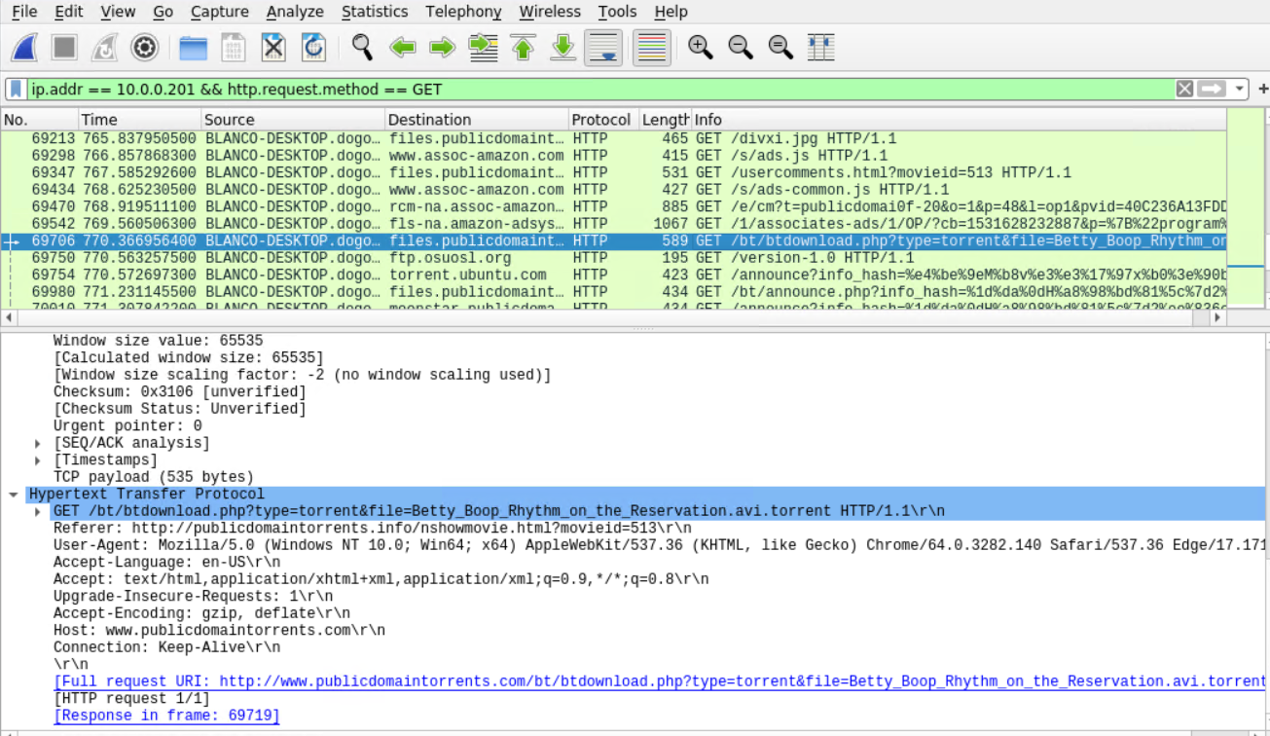
Downloading Torrent
What kind of traffic did you observe? Which protocol(s)? Downloading, web browsing, and general search traffic via HTTP GET requests.
What, specifically, was the user doing? Which site were they browsing? Etc. - Specifically, the user was searching ‘publicdomaintorrents.com’ for downloading potentially illegal/undesirable content.
Include a description of any interesting files. The “interesting file” is a torrent file titled ‘Betty_Boop_Rhythm_on_the_Reservation.avi.torrent’.
No. 69706
GET Request
Malicious Activity: Downloading Torrent

Slide 14
The End
14

